Slide 1
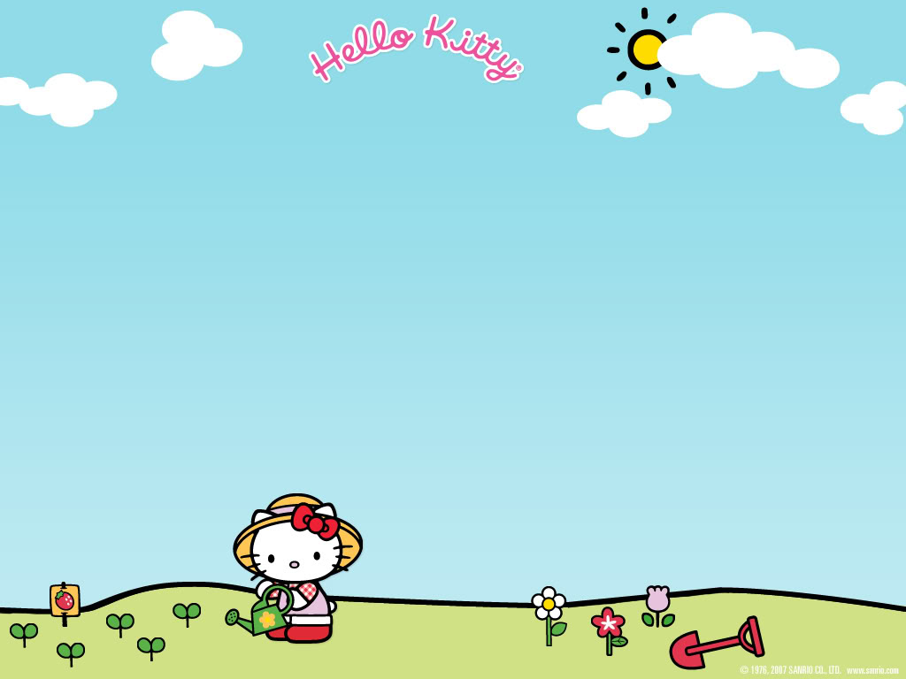
Yen The Primary School
Grade 3

Slide 2
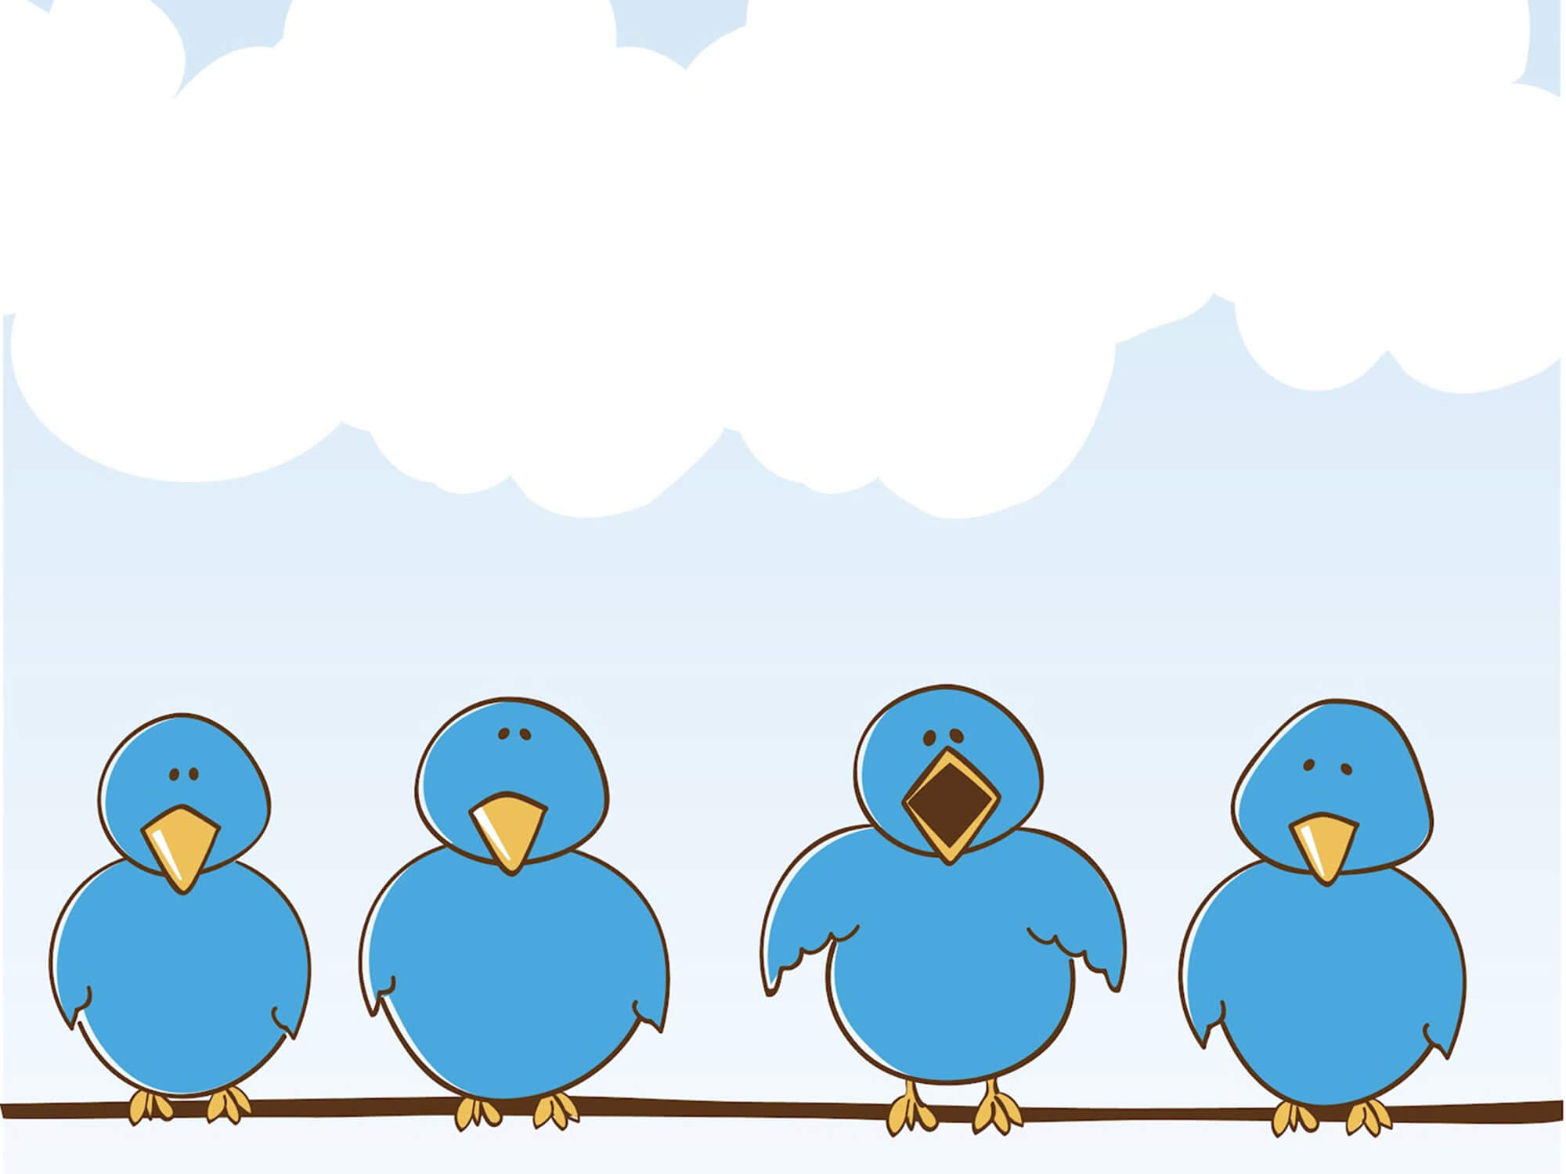
Grade 3 Review 1

Slide 3
Hello everyone!

Slide 4
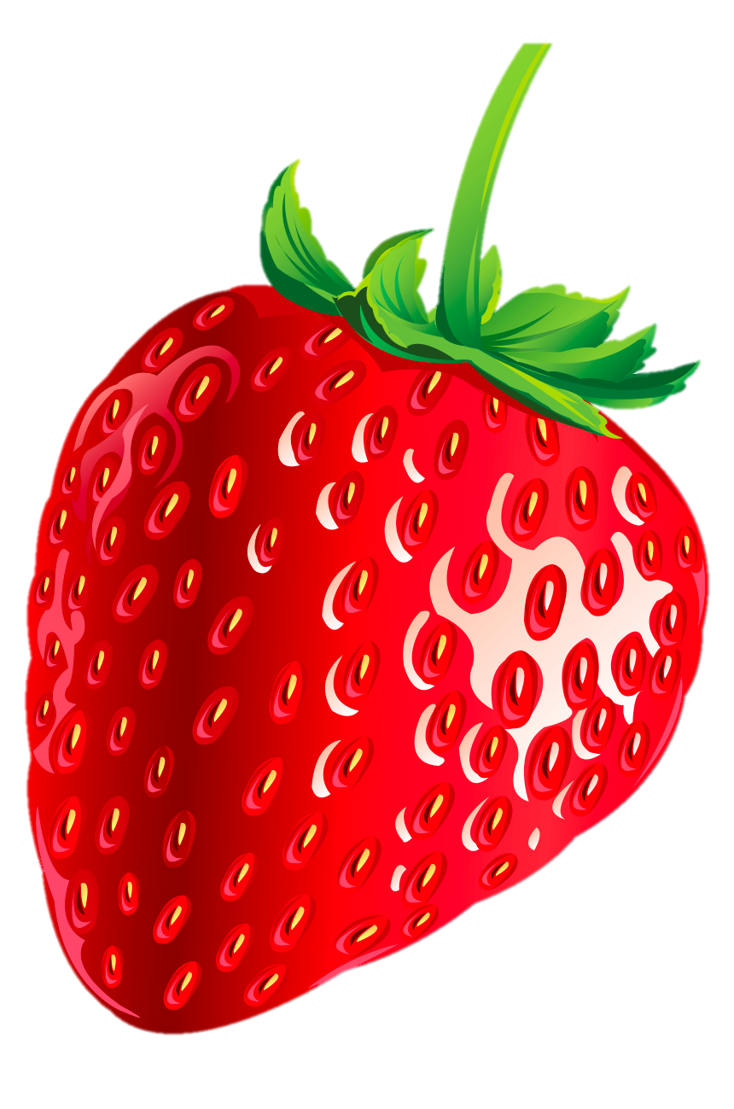
STRAWBERRY
COMPETITION
START
Notes:
Divide the class into 4 groups
Each group choose a snail
Students work in groups to answer these questions

Slide 6
strawberry 1
hadn
hand
answer
back

Slide 7
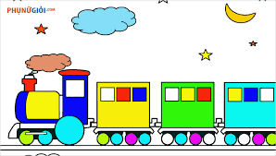
strawberry 2
train
natri
answer
back

Slide 8
strawberry 4
It’s a book.
What’s this?
answer
back

Slide 9
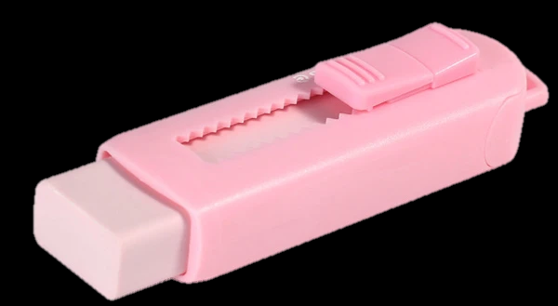
strawberry 1
It’s an eraser.
What’s this?
answer
back

Slide 10
strawberry 3
Is
___ it your pencil?
answer
back

Slide 11
strawberry 4
it isn’t
Is this your bike?
➔No, __________
answer
back

Slide 12
strawberry 1
window
wwindo
answer
back

Slide 13
strawberry 2
this
Is _____ your car?
➔Yes, it is.
answer
back

Slide 14
strawberry 3
nose
sone
answer
back

Slide 15
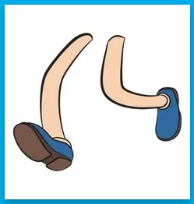
strawberry 1
legs
gels
answer
back

Slide 16
strawberry 2
This is
_______ my face.
answer
back

Slide 17
strawberry 3
oord
door
answer
back

Slide 18
strawberry 4
These are
_________ my pens.
answer
back

Slide 19
1. Circle the odd-one-out. Write.
1. table / milkshake / noodles / pizza . __table___
2. bed / cabinet / shelf / seventeen. ___
3. forty / drawers / eighty / one hundred. ___
4. noodles / thirteen / twenty / fifteen. ____
5. rug / twenty / pillow / blanket. ___
seventeen
drawers
noodles
twenty

Slide 20
1. Does the giraffe have a long neck? ..c....
f
a. Yes, he does.
b. Yes, she does.
c. Yes, it does.
d. No, she doesn't.
e. No, he doesn't.
f. No, it doesn't.
2. Does it have two legs? ……
f
a
a
3. Does the boy have black hair? …….
e
4. Does he have noodles? ……
b
5. Does the girl have long hair? …….
d
6. Does she have a pizza? ……

Slide 21
3. Ask and answer.
Does the giraffe have a long neck?
=> Yes, it does.
Does…?

Slide 22
4. Check (v) the two picture that start with the same sound. Write the letter.
fr
✓
✓
✓
dr
✓
✓
✓
cr

Slide 23
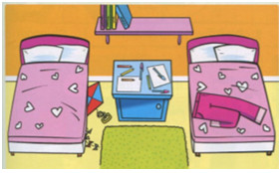
5. Write T (true) or F (false)
There are two beds. ­_T_
2. There's a kite under a bed. ___
3. There are books on the cabinet. ___
4. There are pants on the rug. ___
5. There are pillows on the beds. ___
T
F
F
T

Slide 24
Tasks: Worktime!
Finish the works in your workbook!

Slide 25
Goodbye~!

